Slide 1
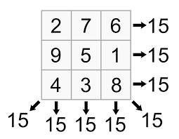
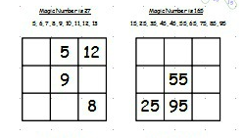
Magic Square
A magic square has all rows adding up to the same number
The magic number is 27
The magic number is 165
Notes:
hook

Slide 2
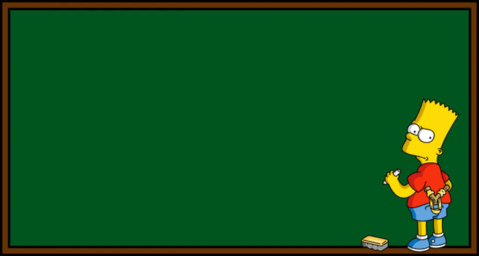
Solving Equations
Learning Objectives:
Able to solve a one-step equation
Able to solve a two-step equation

Slide 3
24
7
30
Date
Solving Equations with backtracking
EQ –How do I use the backtracking method to solve equations?
5
Notes:
Lesson objective (EQ)

Slide 4


Remember that the number of cubes in the box is equal to m
If I add 3 cube to box how many cubes are in the box now?
m

Slide 5
If we count how many are in the box now we find that there are 10 cubes in the box.
We are going to undo what we have done to work it out.
We added 3, so now we need to take away 3
    m + 3 = 10
m +3 10
m -3 10
m

Slide 6
Solving equations
So
x = 11!!
Find the value of x if:
x + 9 = 20
x
+ 9
20
11
- 9
20

Slide 7
Solving equations
So
x = 46!!
Find the value of x if:
x - 13 = 33
x
-13
33
46
+ 13
33

Slide 8
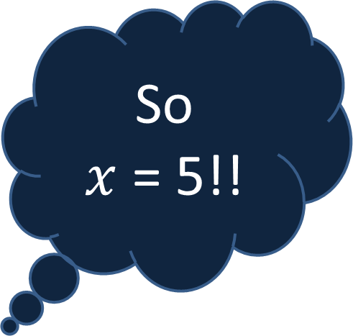


Solving equations
So
$x$ = 5!!
Find the value of $x$ if:
4$x$ + 7 = 27
$$x$$
x 4
+ 7
27
20
5
÷ 4
- 7
27

Slide 9

Solving equations
So
$x$ = 5!!
Find the value of $x$ if:
20$x$ – 15 = 85
$$x$$
x 20
- 15
85
100
5
÷ 20
+15
85

Slide 10

Solving Equations
Solve the following equations, showing your working out
a + 5 = 12
b – 6 = 20
c + 17 = 32
d – 9 = 36
e + 26 = 51
a = 7
6) 2f + 3 = 9
4g – 15 = 9
7h – 20 = 15
10i + 27 = 97
$\frac{j}{5}$ + 9 = 17
f = 3
b = 26
g = 6
c = 15
h = 5
d = 45
i = 7
e = 25
j = 40

Slide 11
Riddle
Two fathers and two sons sat down to eat eggs for breakfast. They ate exactly three eggs, each person had an egg. The riddle is for you to explain how
Answer: There were 3 people Grandad, Dad and Son.
Notes:
Closure

